Slide 1
Poverty in EU between 2010 - 2020.
Python,API wrapper, MySQL and Excel.
Damian Borsiak and Jaime Sastre Crespo.

Slide 2
0. Index.
Goal of the project.
Flowchart.
Composite Indicator methodology.
Challenges.
Highlights and possibilities of improvement.
Main results.
Demo
Q&A Time!

Slide 3
1. Goal of the project.
Identify countries with the highest and lowest poverty rate between 2010 and 2020 in the EU.
And compare the accuracy between our indicator and a external and existing one.

Slide 4
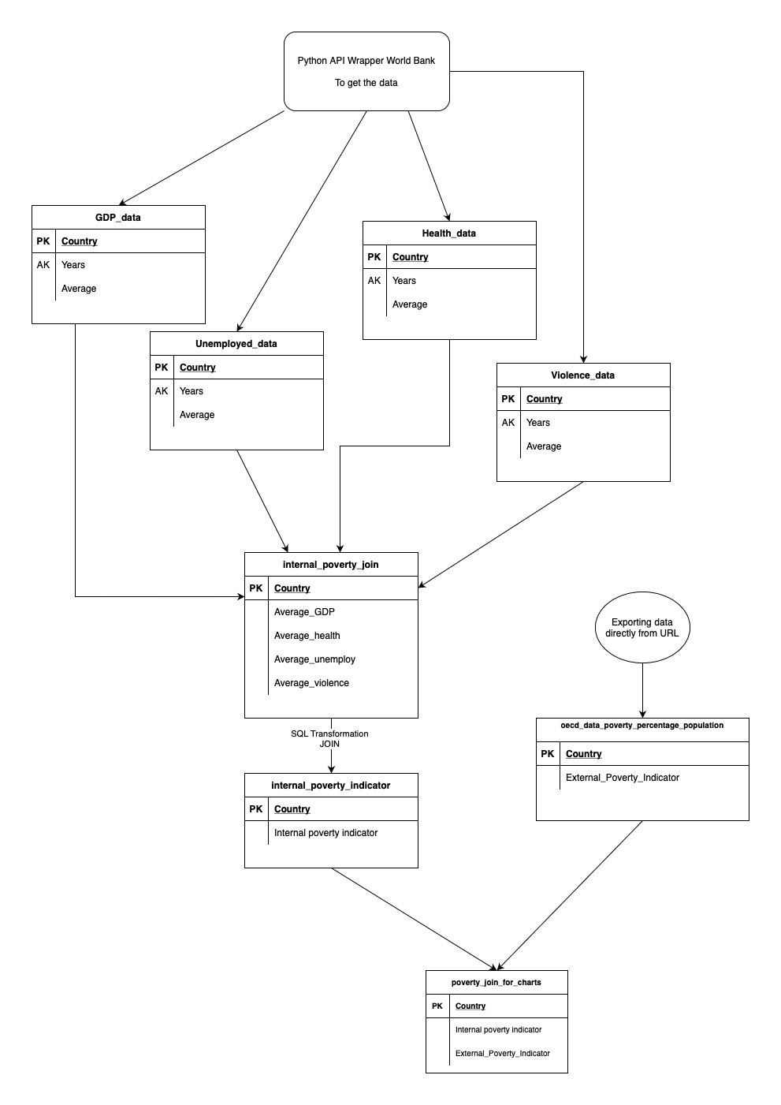
2. Flowchart.
Get the data through API Wrapper with Python.
https://data.worldbank.org/
4 tables as variables
GDP per capita per country($);
Expenditure on health care (%);
Unemployment rate (%);
Violence (per 100.000 people).
LEFT JOIN on MySQL to get our poverty indicator.
Exporting data of an external indicator.
https://data.oecd.org/inequality/poverty-rate.htm
LEFT JOIN on MySQL to have a table with both:
internal_poverty_indicator
external_poverty_indicator

Slide 5
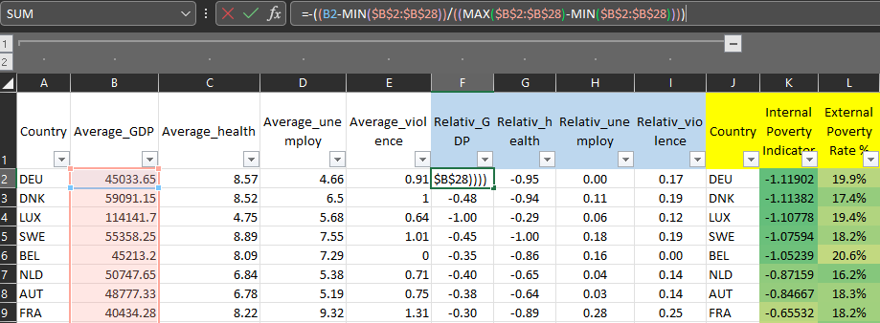
3. Composite Indicator methodology
(to normalize values).
poverty = - GDP - Health + Unemploy + Violence
x1 = (x-min(x))/(max(x)-min(x)) || To normalize values.

Slide 6
4. Challenges.
Incomplete data/ find reliable data.
No data for Portugal in the external indicator.
Missing values in some years of our variables.
Work with join left SQL for the first time.
Missing variables that we considered important (we wanted to introduce : corruption, school).

Slide 7
5. Highlights & possibilities of improvement.
As highlights:
We have noticed similars trends between our and external indicators
But we still have noticed few countries with significance differences.
As possibilities of improvement:
Find data more accurate and reliable.
Bigger number of variables.

Slide 8
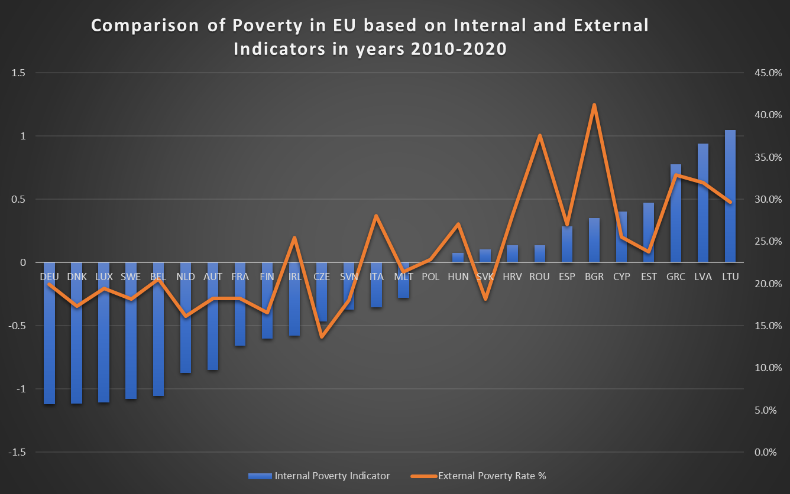


6. Main results .
MIN poverty
MAX poverty

Slide 9
7. Demo
https://github.com/JaimeSastreCrespo/Project_2_Python_SQL_Poverty/tree/main
https://github.com/Borysdb/Project_2_Python_SQL_Poverty.git

Slide 10
8. Q&A TIME, PLEASE ):

Slide 11

LEVEL OF POORNESS AFTER THE BOOTCAMP

